Slide 1
尼諾思科技股份有限公司 報告人：teuton
Unit test & OOC 簡報

Slide 2
大綱
概念介紹
OOC
SOLID Design Principle
Test double
Embedded TDD cycle
CGreen

Slide 3
OOC

Slide 4
Encapsulation : declare object data type
/* shape.h */
typedef struct {
char* __name;
double __x;
double __y;
}Shape;

Slide 5
Encapsulation : declare object methods
/* shape.h */
/* Shape's operations (Shape's interface)... */
void Shape_ctor(Shape * this, const char* name, double x, double y);
void Shape_moveby(Shape * this, double dx, double dy);
double Shape_gety(Shape * this);
void Shape_setx(Shape * this, double x);

Slide 6
Encapsulation : implement object constructor
/* shape.c */
#include "shape.h"
/* object constructor*/
void Shape_ctor(Shape * this, double x, double y){
this->__x = x;
this->__y = y;
}

Slide 7
Encapsulation : implement object method
/* shape.c */
void Shape_moveby(Shape* this, double dx, double dy){
this->__x += dx;
this->__y += dy;
}
void Shape_sety(Shape * this, double y){
this->__y = y;
}

Slide 8
Encapsulation : use object method
/* shape.c */
Shape test_sq;
Shape_ctor(&test_sq, "sqareTS", 2.1, 3.3);
Shape_moveby(&test_sq, 1.1, 2.3); /* __x = 3.2, __y = 5.6 */
Shape_sety(&test_sq, 2.7); /* __x = 3.2, __y = 2.7 */

Slide 9
Inheritance : declare object inheritance and its method
/* rect.h */
#include"shape.h"
typedef struct {
Shape super; /* <== inherits Shape */
double __width;
double __height;
} Rectangle;
double Rectangle_getWidth(Rectangle * this);

Slide 10
Inheritance : implement object constructor
/* rect.c */
#include"rect.h"
void Rectangle_ctor(Rectangle * this, char* name, double x, double y, double width, double height){
Shape_ctor(&this->super, name, x, y);
this->__width = width;
this->__height = height;
}

Slide 11
Inheritance : use inheritance method
/* rect.c */
Rectangle rec;
Rectangle_ctor(&rec, "rect3", 2.1, 3.2, 4.5, 5.4);
Rectangle_getHeight(&rec) /* 5.4 */
Shape_moveby(&rec.super, 1.1, 2.2); // __x = 3.2, __y = 5.4

Slide 12
Polymorphism : virtual pointer and virtual table
typedef struct {
Shape super;
double __rad;
} Circle;
typedef struct {
struct ShapeVtbl *vptr;
char* __name;
double __x;
double __y;
}Shape;
struct ShapeVtbl{
void (*xtor)(Shape * this);
double (*area)(Shape * this);
void (*draw)(Shape * this);
};
typedef struct {
Shape super;
double __width;
double __height;
} Rectangle;
static void Circle_xtor_(Shape * this);
static double Circle_area_(Shape * this);
static void Circle_draw_(Shape * this);
static void Shape_xtor_(Shape * this);
static double Shape_area_(Shape * this);
static void Shape_draw_(Shape * this);
static void Rectangle_xtor_(Shape * this);
static double Rectangle_area_(Shape * this);
static void Rectangle_draw_(Shape * this);

Slide 13
Polymorphism : declare virtual pointer
/* shape.h */
struct ShapeVtbl; /* forward declaration */
typedef struct {
struct ShapeVtbl *vptr; /* <== Shape's Virtual Pointer */
char* __name;
double __x;
double __y;
}Shape;

Slide 14
Polymorphism : declare virtual table
/* shape.h */
struct ShapeVtbl{
void (*xtor)(Shape * this);
double (*area)(Shape * this);
void (*draw)(Shape * this);
};

Slide 15
Polymorphism : declare virtual function call
/* shape.h */
static inline double Shape_area(Shape * this) {
return (*this->vptr->area)(this);
}
static inline void Shape_draw(Shape * this) {
(*this->vptr->draw)(this);
}

Slide 16
Polymorphism : declare virtual function prototypes
/* shape.c */
#include "shape.h"
/* Shape's prototypes of its virtual functions */
static void Shape_xtor_(Shape * this);
static double Shape_area_(Shape * this);
static void Shape_draw_(Shape * this);

Slide 17
Polymorphism : basic object constructor with Polymorphism
/* shape.c */
void Shape_ctor(Shape * this, double x, double y){
static struct ShapeVtbl vtbl = { /* vtbl of the Shape class */
&Shape_xtor_,
&Shape_area_,
&Shape_draw_
};
this->vptr = &vtbl; /* "hook" the vptr to the vtbl */
this->__x = x;
this->__y = y;
}

Slide 18
Polymorphism : implement basic virtual function
/* shape.c */
static double Shape_area_(Shape * this) {
assert(0); /* purely-virtual function should never be called */
return 0.0; /* to avoid compiler warnings */
}
static void Shape_draw_(Shape * this) {
assert(0); /* purely-virtual function should never be called */
}

Slide 19
Polymorphism : declare virtual function for higher objects
/* rect.c */
#include "rect.h"
/* Rectangle's prototypes of its virtual functions */
static void Rectangle_xtor_(Shape * this);
static double Rectangle_area_(Shape * this);
static void Rectangle_draw_(Shape * this);

Slide 20
Polymorphism : inheritance object constructor with Polymorphism
/* rect.c */
void Rectangle_ctor(Rectangle * this, char* name, double x, double y, double width, double height){
static struct ShapeVtbl vtbl = { /* vtbl of the Rectangle class */
&Rectangle_xtor_,
&Rectangle_area_,
&Rectangle_draw_
};
Shape_ctor(&this->super, name, x, y); /* call the superclass' ctor */
this->super.vptr = &vtbl; /* override the vptr */
this->__width = width;
this->__height = height;
}

Slide 21
Polymorphism : implement virtual function for inheritance object
/* rect.c */
double Rectangle_area_(Shape * this) {
Rectangle * this_ = (Rectangle *)this; /* explicit downcast */
return this_->__width * this_->__height;
}
void Rectangle_draw_(Shape * this) {
Rectangle * this_ = (Rectangle *)this; /* explicit downcast */
printf("Rectangle_draw_(x=%f2,y=%f2,width=%f2,height=%f2)\n", Shape_getx(this), Shape_gety(this), this_->__width, this_->__height);
}

Slide 22
SOLID Design principle

Slide 23
Single responsibility principle (bad)
double Shape_area_sum(Shape* [] shapes, int nShapes) {
/* iterate shapes and get sum here*/ /* print result here */ /* that’s two jobs! */
/* what if I change sum or print and affect each other? */
}
A class should have one and only one reason to change, meaning that a class should have only one job.

Slide 24
Single responsibility principle (fixed)
double Shape_area_sum_calculate(Shape* [] shapes, int nShapes) {
/* iterate shapes and get sum, return result here*/
}
void Shape_area_sum_print(double sums) {
/* print result here*/
}

Slide 25
Open closed principle (bad)
for (i = 0, i < nShapes, i++) {
if ( /* shapes[i] is circle*/) {
/* calculate circle area */
} else if ( /* shapes[i] is rectangle */) {
/* calculate circle area */
}
/* what if there are additional shapes? */
}
Objects or entities should be open for extension but closed for modification.

Slide 26
Open closed principle (fixed)
/* rect.c */
double Shape_area(Shape *this){
Rectangle * this_ = (Rectangle *)this;
return this_->__width * this_->__height;
}
/* circle.c */
double Shape_area(Shape *this){
Circle * this_ = (Circle *)this;
return 3.14 * this_->__radius * this_->__radius;
}
/* main.c */
for (i = 0, i < nShapes, i++) { /* shapes[i] = &circle.super or &rect.super */
sum += Shape_area(shapes[i]);
}

Slide 27
Liskov substitution principle (bad)
Let q(x) be a property provable about objects of x of type T. Then q(y) should be provable for objects y of type S where S is a subtype of T.
typedef struct {
void (*fly)(Bird* this);
} Bird;
typedef struct {
Bird super;
/* can Ostrich fly? */
} Ostrich;

Slide 28
Liskov substitution principle (fixed)
/* remove fly function from Bird because not every Bird can fly. If you have to keep the fly function, make sure that every object that inheritance Bird can fly (use all Bird method) */
typedef struct {
void (*fly)(Bird* this);
} Bird;
typedef struct {
/* attributes for Ostrich */
} Ostrich;

Slide 29
Interface segregation principle (bad)
typedef struct {
/* Shape 2D attributes here */
double (*volume)(Shape*); // 3D
} Shape; typedef struct {
Shape super;
/* why should I use volume? */
} Square;
A client should never be forced to implement an interface that it doesn’t use, or clients shouldn’t be forced to depend on methods they do not use.

Slide 30
Interface segregation principle (fixed)
typedef struct {
Shape super;
/* exclusive 2D attributes here */
} 2DShape;
typedef struct {
Shape super;
double (*volume)(Shape*); /*an exclusive 3D attributes */
} 3DShape;
typedef struct {
2DShape super;
/* exclusive Square attributes here */
} Square;

Slide 31
Dependency inversion principle (bad)
dbConn = connect(MySQLConnection dbConnection);
/* What if MySQL is changed into Mongal DB? */
Entities must depend on abstractions, not on concretions. It states that the high-level module must not depend on the low-level module, but they should depend on abstractions.

Slide 32
Dependency inversion principle (fixed)
typedef struct {
Connection super;
} MySQLConn;
typedef struct {
Connection super;
} MongalDBConn;
/* use MySQLConn.super or MongalDBConn.super */
dbConn = connect(Connection dbConnection);

Slide 33
Test Double

Slide 34
Tests are FIRST
Fast: tests are fast
Isolated: tests are independent of each other
Repeatable: always gives the same result
Self-verifying: return “Pass” or “Fail”
Timely: write just in time before production code

Slide 35
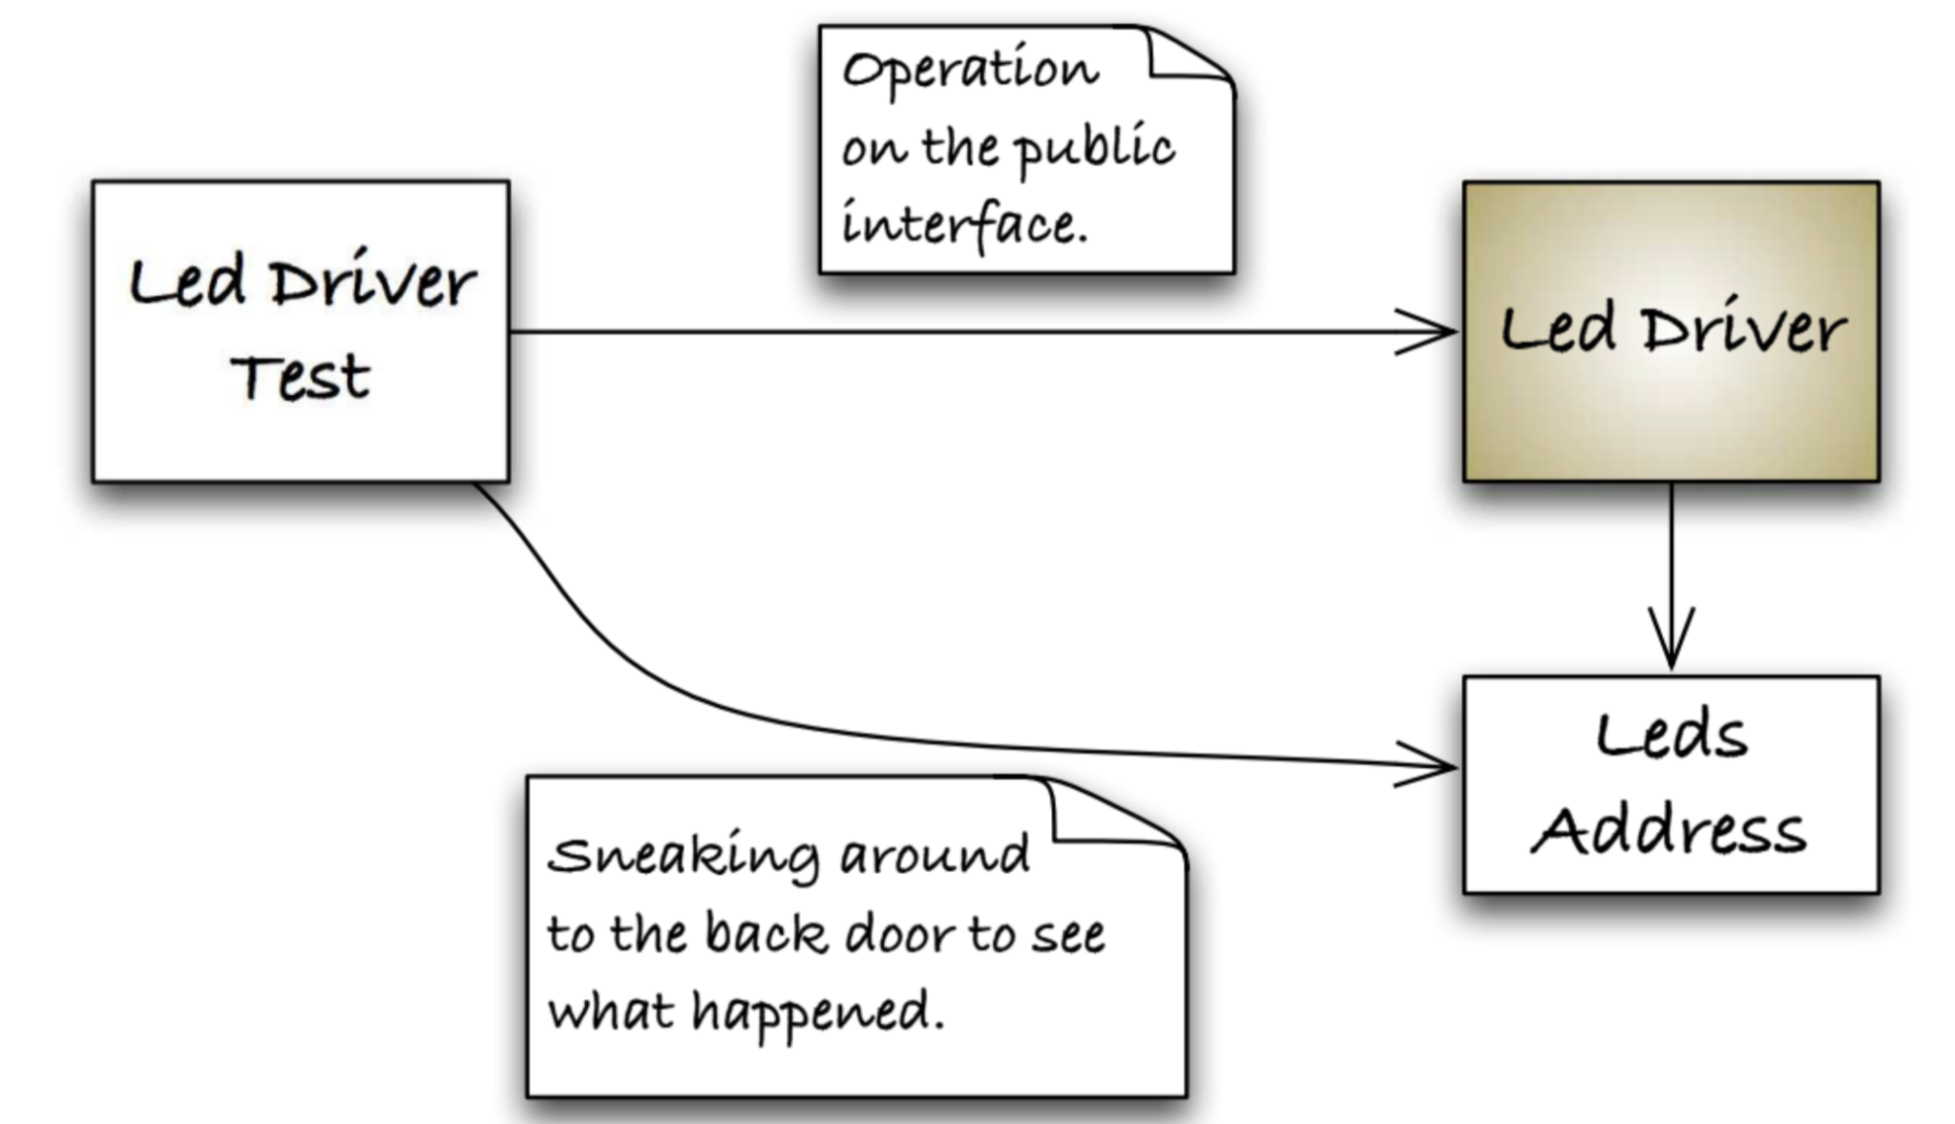
How do you test outside CUT?
(you cannot control this)

Slide 36
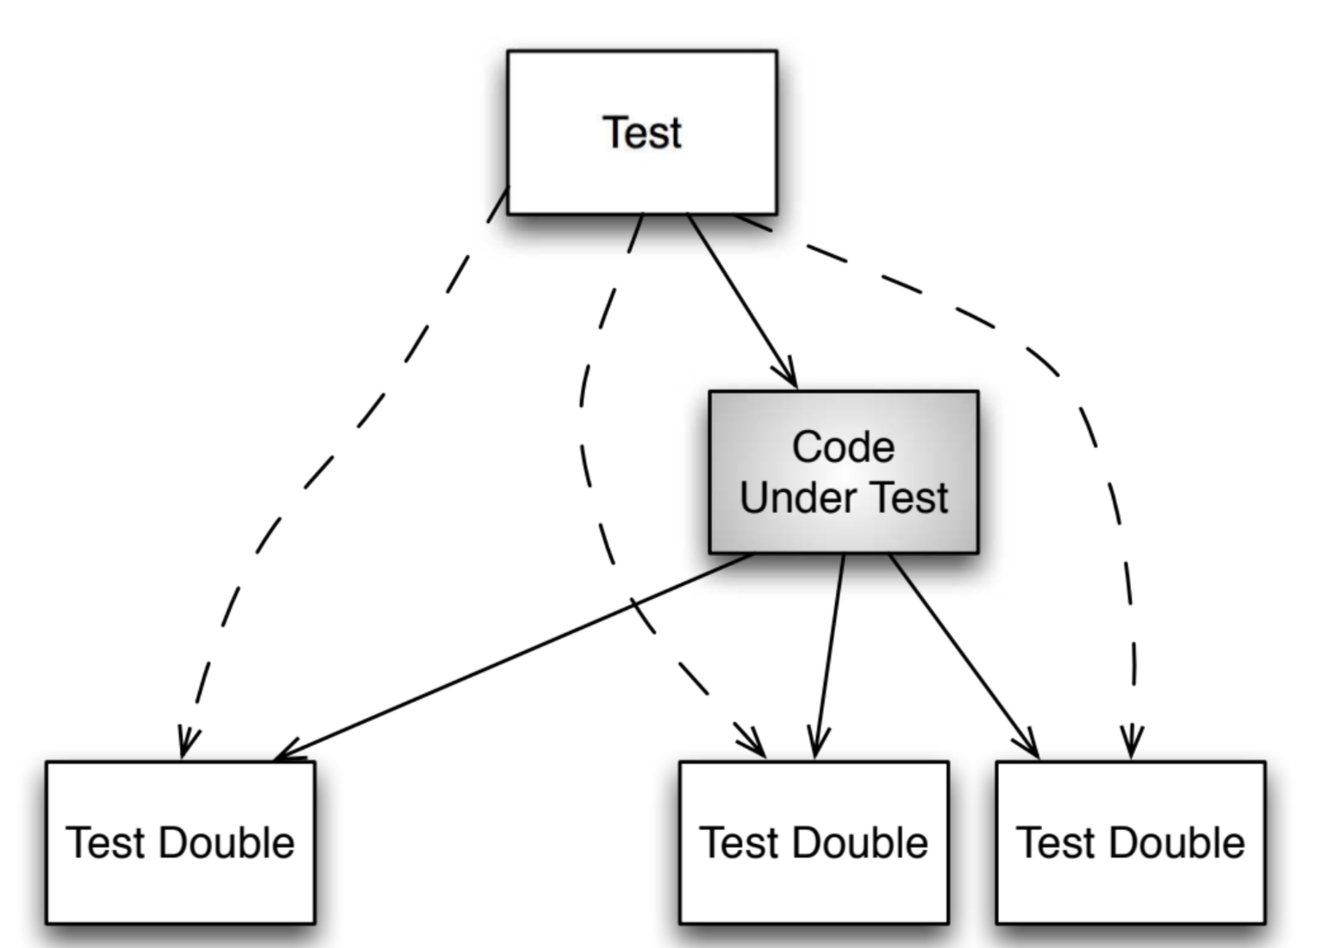
Simpliffy relationship

Slide 37
When to use test double?
Hardware independence
Inject difficult to produce input(s)
Speed up a slow collaborator
Dependency on something volatile (e.g. Time)
Dependency on something under development
Dependency on something that is difficult to configure

Slide 38
Test dummy
“I exist” (to pass compilation)
void Nothing(DummyOb* obj){}

Slide 39
Test stub
return some value
int Stub_add_up(StubObj* obj){
return 3;
}
Stub_add_up(&stubObj) == 3 ;

Slide 40
Test spy
Capture parameter
int Spy_add_up(SpyObj* obj){
obj->called_add = true;
return obj->a + obj->b;
}
Spy_add_up(&spyObj) == 3;
spyy.called_add == true;

Slide 41
Mock object
Verify function called
/* determine what parameter to observe at given phase */
void mocked_callback(int x, int y) {mock(x, y);}
/* main function to observe */
void Mock_add_more(MockObj* obj){
mocked_callback(obj->a, obj->b); // observe ‘a’ and ‘b’ here
obj->a += 1;
obj->b += 2;
mocked_callback(obj->a, obj->b); // observe ‘a’ and ‘b’ here
}

Slide 42
Mock object
/* declare parameter status in order */
expect(mocked_callback,
when(x, is_equal_to(2)),
when(y, is_equal_to(1)));
expect(mocked_callback,
when(x, is_equal_to(3)),
when(y, is_equal_to(3)));
Mock_add_more(&mockObj); // call function

Slide 43
Embedded TDD Cycle

Slide 44
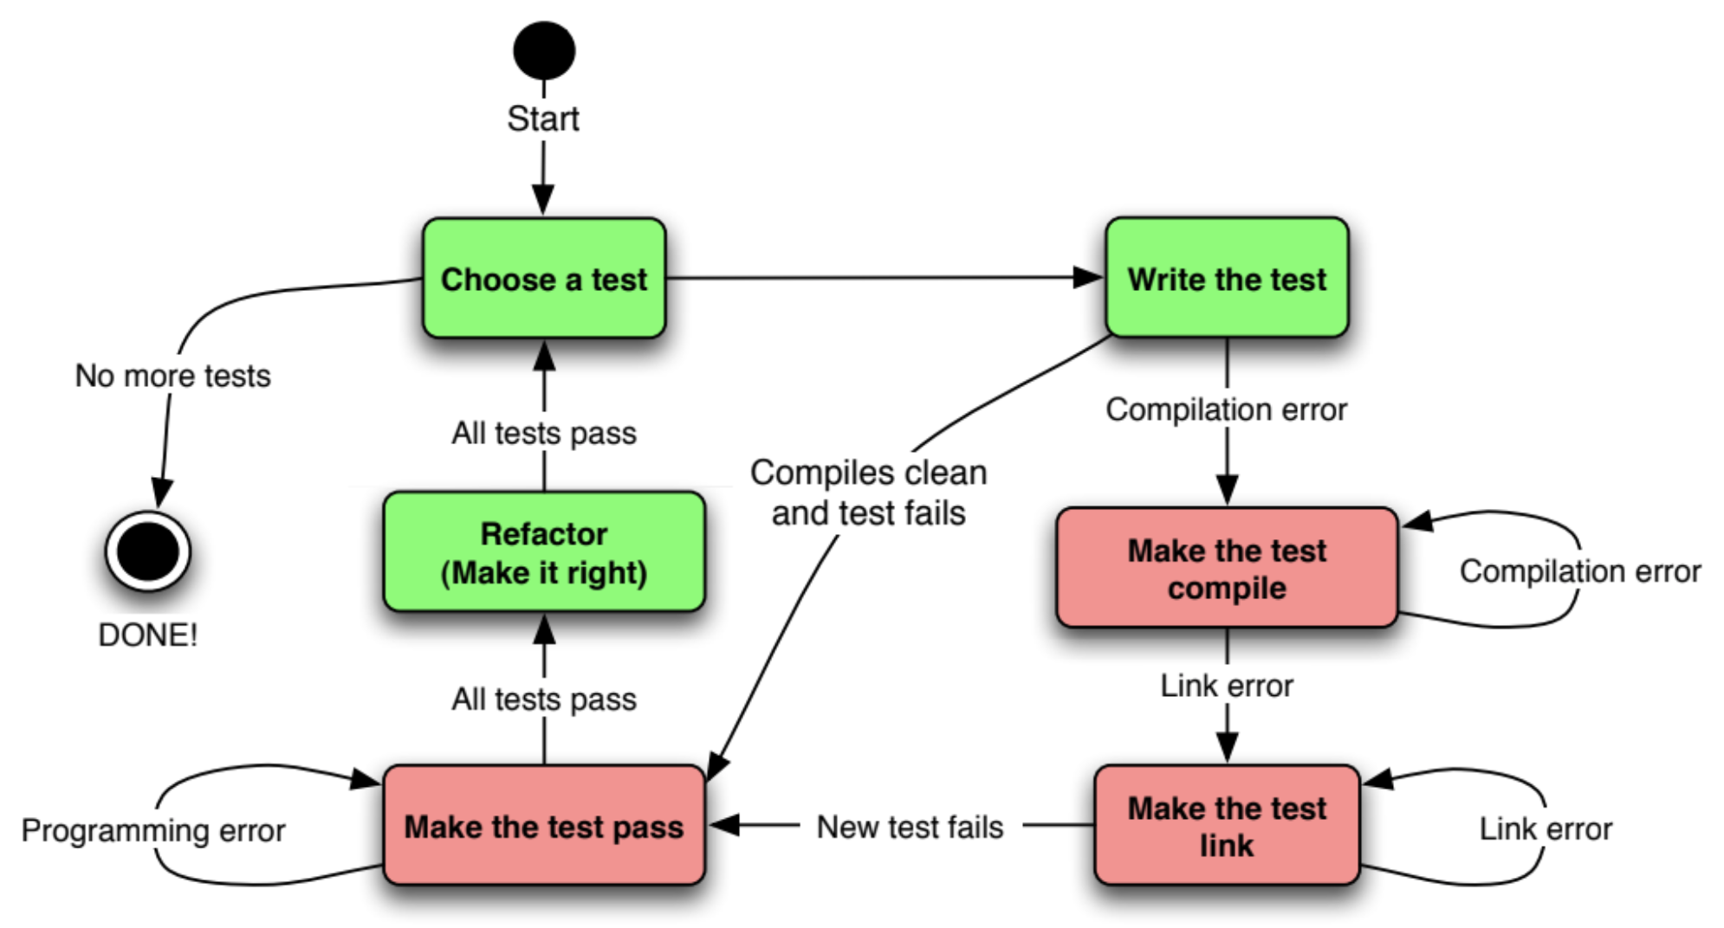
TDD cycle

Slide 45
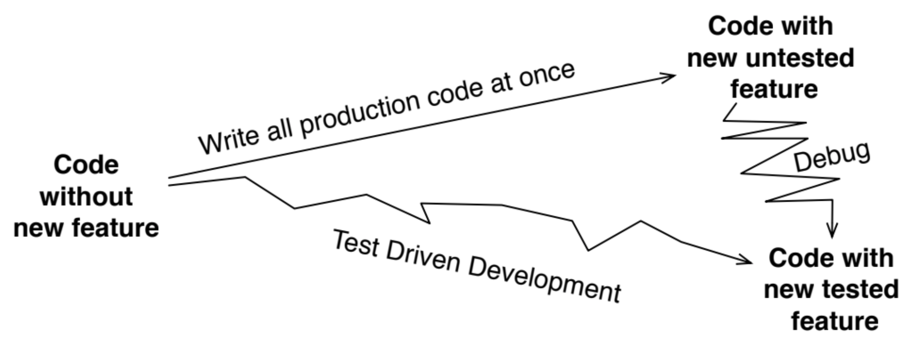
Why TDD?

Slide 46
The target hardware bottleneck
Target hardware is not ready
Target hardware is expensive/scarce
Target hardware may have bug of its own
Longer target build time
Longer target upload time
Compiler difference

Slide 47
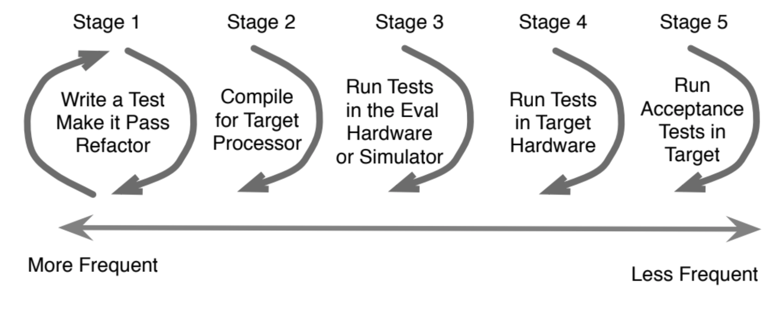
Embedded TDD Cycle

Slide 48
Embedded TDD Cycle stages
TDD microcycle: compile and run platform-independent code on host development system.
Compiler compatibility check: compile for the target.
Run unit tests in an eval board: see if the compiled code run as expected on target processor.
Run unit tests in the target hardware: same as 3 but on target hardware. Run hardware-specific tests here.
Run acceptance tests in the target: make sure that product features work

Slide 49
CGreen 簡介

Slide 50
What is CGreen?
open source unit tester for C and C++
apt-get install cgreenl

Slide 51
CGreen Testifle part1
#include <cgreen/cgreen.h>
Describe(FirstTest);
BeforeEach(FirstTest) {}
AfterEach(FirstTest) {}
Ensure(FirstTest, addUp) {
assert_that(strlen(“hello”), is_equal_to(5));
}

Slide 52
CGreen Testifle part2
Ensure(FirstTest, dummy) {
assert_that(3, is_equal_to(3));
}
TestSuite *FirstTest_tests() {
TestSuite *suite = create_test_suite();
add_test_with_context(suite, FirstTest, addUp);
add_test_with_context(suite, FirstTest, dummy);
return suite;
}

Slide 53
CGreen main file
#include <cgreen/cgreen.h>
TestSuite *FirstTest_tests();
int main(int argc, char **argv) {
TestSuite *suite = create_test_suite();
add_suite(suite, FirstTest_tests());
if (argc > 1) {
return run_single_test(suite, argv[1], create_text_reporter());
}
return run_test_suite(suite, create_text_reporter());
}

Slide 54
How does CGreen resemble BDD?
Describe(Strlen);
BeforeEach(Strlen) {}
AfterEach(Strlen) {}
Ensure(Strlen, returns_five_for_hello) {
assert_that(strlen("Hello"), is_equal_to(5));
}
TestSuite *our_tests() {
TestSuite *suite = create_test_suite();
add_test_with_context(suite, Strlen, returns_five_for_hello);
return suite;
}

Slide 55
CGreen constraints example
is_true, is_non_null (Basic)
is_equal_to(value), is_less_than(value) (Integer)
is_equal_to_string(value), ends_with_string(value) (String)
is_equal_to_double(value), is_greater_than_double(value) (Double)
assert_that(expected, constraint)
assert_that_double(expected, constraint)

Slide 56
Thank You. 簡報完畢

